Slide 1




AI IN PLANNING & DECISION MAKING
ENERGY CONSUMPTION PREDICTION
PROJECT BY:
KAINAT AIJAZ - R1J01U
VAIDEHEE KORE - CZYJFC
next

Slide 2



AI IN PLANNING & DECISION MAKING
02
PROBLEM STATEMENT
The primary problem is understanding and predicting energy consumption patterns to optimize energy usage, reduce wastage, and better plan energy production.
Colab Book link
next

Slide 3


AI IN PLANNING & DECISION MAKING
03
PROPOSED AI SOLUTION
To develop an AI-based model that accurately predicts energy consumption based on historical data and specific input parameters (e.g., time of day). Enable informed decision-making for energy providers and consumers to optimize usage and reduce wastage.
next

Slide 4


AI IN PLANNING & DECISION MAKING
04
DATA COLLECTION & ANALYSIS
Dataset Details:
-Household power consumption dataset from Kaggle (CSV)
-Include many features for accurate prediction such as:
Date, Time, Global Active Power, Voltage, Sub-metering values.
next

Slide 5


AI IN PLANNING & DECISION MAKING
05
DATA PREPROCESSING
Data Cleaning: Filled out all the missing values in any column.
Feature Engineering: Combined Date and Time column to create a new DateTime column, extracted time based features such as time and day of the week.
Normalized energy consumption columns for better model performance
next

Slide 6
AI IN PLANNING & DECISION MAKING
06
DATA PREPROCESSING
Divided dataset into training (80%) and testing (20%)
Set X (input variable) to be Time of the day and Y (target variable) to Global Active Power.
next

Slide 7




AI IN PLANNING & DECISION MAKING
07
MODEL SELECTION
Simple but less accurate for non-linear trends.
Better accuracy by capturing complex patterns.
NEURAL NETWORKS
LINEAR REGRESSION
next

Slide 8
AI IN PLANNING & DECISION MAKING
08
MODEL TRAINING
Trained both the models using date time and energy features.
Calculated MSE and R-squared error from both the models to evaluate performance.
Visualized and compared the performance using residual plots and heatmap.
next

Slide 9
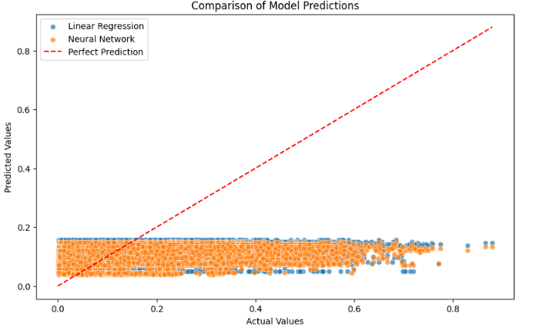
MODEL PERFORMANCE
AI IN PLANNING & DECISION MAKING
09
next

Slide 10


AI IN PLANNING & DECISION MAKING
10
MODEL EVALUATION
Metrics Used: Mean Absolute Error (MAE), Root Mean Square Error (RMSE).
Neural Network Performance: Outperformed Linear Regression in prediction accuracy.
Trade-offs: Higher computational cost, but better results.
next

Slide 11


AI IN PLANNING & DECISION MAKING
11
CHOSEN SOLUTION
Final Decision: Implemented a Neural Network model.
Reason: Best balance of accuracy and practical applicability.
next

Slide 12


AI IN PLANNING & DECISION MAKING
12
DECISION IMPLEMENTATION
Implemented the solution using trained neural network model by taking input time of the day from the user and predict energy consumption at that specific time.
Tools used: Python, Google Colab, Gemini
next

Slide 13

AI IN PLANNING & DECISION MAKING
14
THANK YOU!
ANY QUESTION?

Slide 14
AI IN PLANNING & DECISION MAKING
13
APPLICATIONS AND IMPACT
Use Case: Energy providers can optimize distribution.
Benefits: Reduce energy waste, save costs, improve sustainability.
next

